Slide 1
Unit 5
Teacher: iddo sadeh

Slide 2
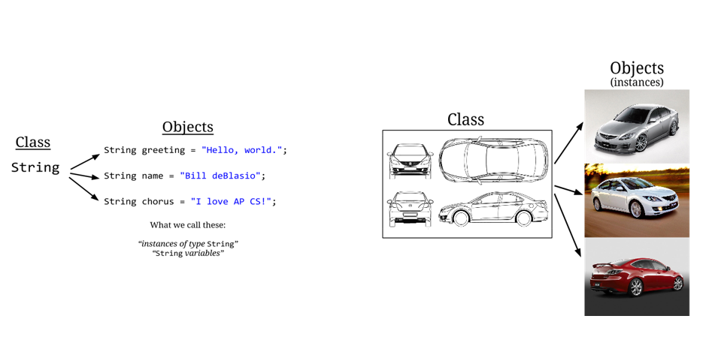
Class and objects
*taken from Teals program
Notes:
Class classifies a type and what objects (data/ type) of that type do
https://runestone.academy/runestone/books/published/apcsareview/JavaBasics/introClassObject.html
Example of creating class
https://runestone.academy/runestone/books/published/apcsareview/JavaBasics/firstOOClass.html

Slide 3
Anatomy of a java class
a class in programming defines a new abstract data type. When you create objects, you create new variables or instances of that class data type.
To write your own class, you typically start a class declaration with public then class then the name of the class. The body of the class is defined inside a { and a }. Then, you can create objects of that new House type by using Classname objectname = new Classname();

Slide 4
Class example
https://runestone.academy/runestone/books/published/apcsareview/JavaBasics/firstOOClass.html

Slide 5
Parts of java class
https://runestone.academy/runestone/books/published/apcsareview/JavaBasics/partsOfAClass.html
Notes:
Go over link and ask students to start lab

Slide 6
Comments (preconditions and postconditions)
As your programs become more complex, comments are a good practice.
https://csawesome.runestone.academy/runestone/books/published/csawesome/Unit5-Writing-Classes/topic-5-3-comments-conditions.html
Notes:
Question 1 2 3

Slide 7
Using methods
Using methods is good practice to reduce complexity of code, organization and avoiding reused of code.
https://csawesome.runestone.academy/runestone/books/published/csawesome/Unit5-Writing-Classes/topic-5-6-writing-methods.html
Notes:
Question 4

Slide 8
Static variables/methods
a static variable is a variable that has been allocated "statically", meaning that its lifetime (or "extent") is the entire run of the program.
The static keyword is placed right after the public/private modifier and right before the type of variables and methods in their declarations
https://csawesome.runestone.academy/runestone/books/published/csawesome/Unit5-Writing-Classes/topic-5-7-static-vars-methods.html

Slide 9
Scope and access
https://csawesome.runestone.academy/runestone/books/published/csawesome/Unit5-Writing-Classes/topic-5-8-scope-access.html

Slide 10
this
https://csawesome.runestone.academy/runestone/books/published/csawesome/Unit5-Writing-Classes/topic-5-9-this.html

